Slide 1
Devops tutorial
Contents
What is Devops
Advantages of Devops in Real time world
What is Jenkins
Version control repositories ( GitHub/Bitbucket)
Waterfall Vs Agile model
Setup JDK ( Set environment variables)
Install Jenkins on Local machine
Configure your first Job
What is Jenkins Pipeline

Slide 2
What is Devops
Devops means Development + Operations
Development includes the following :
Planning the procedure
Development of code
Build the code
Testing ( using testing tools like selenium, Junit, cucumber etc.,)
Operations includes the following :
Scalability
Server stability and maintenance
Integration
Traffic and load balancing
And All other server maintenance

Slide 3
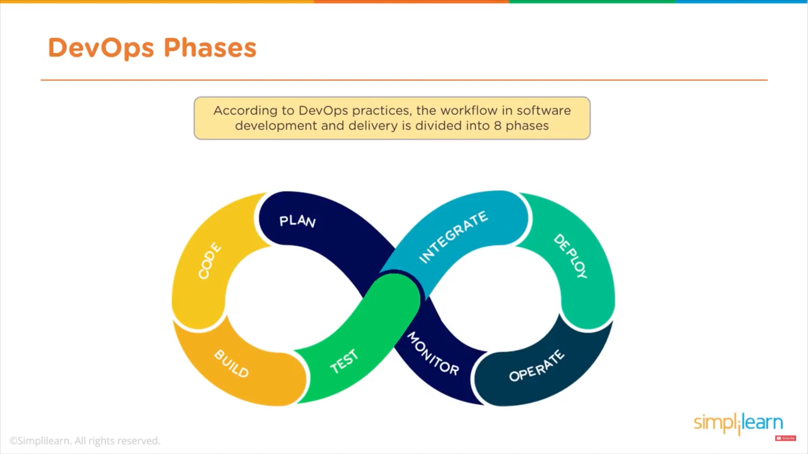
Devops is not a tool or a Software or a programming language
Devops is an approach of deploying a developed code/application into production with a high velocity.

Slide 4
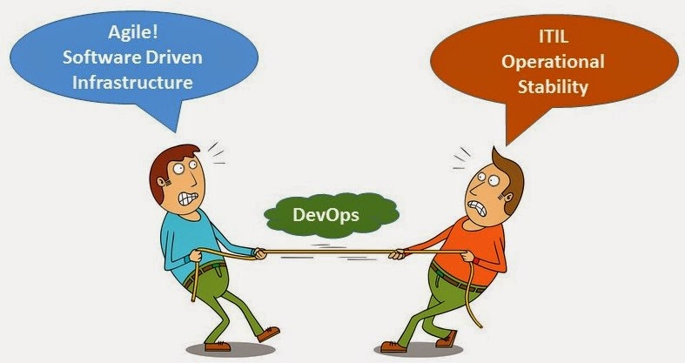
The Blame Game

Slide 5
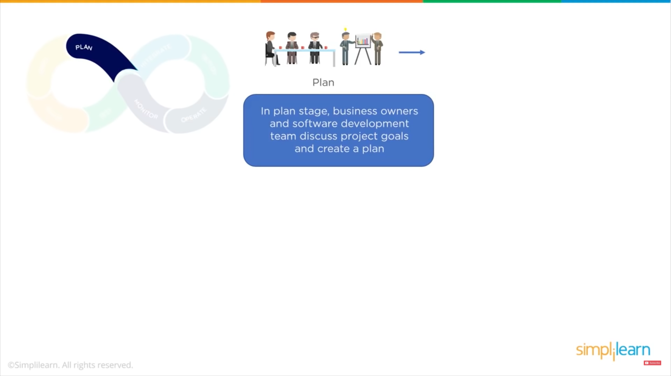

Slide 6
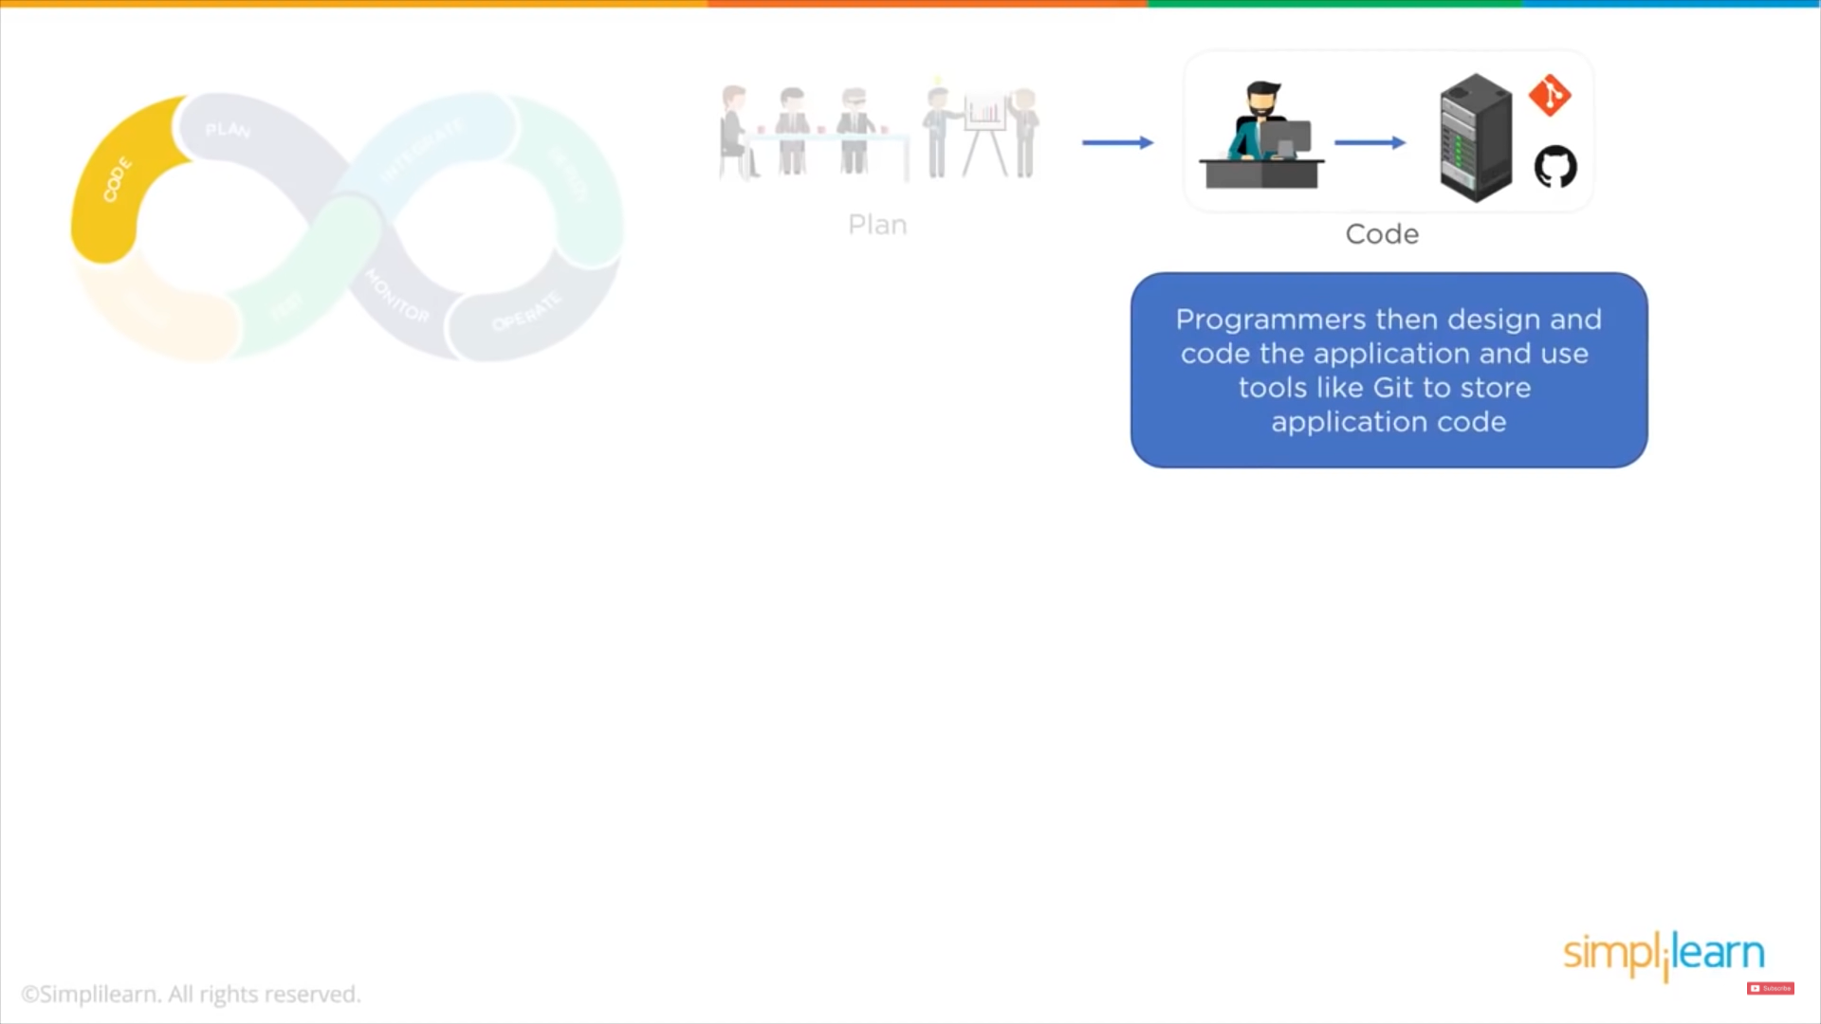

Slide 7
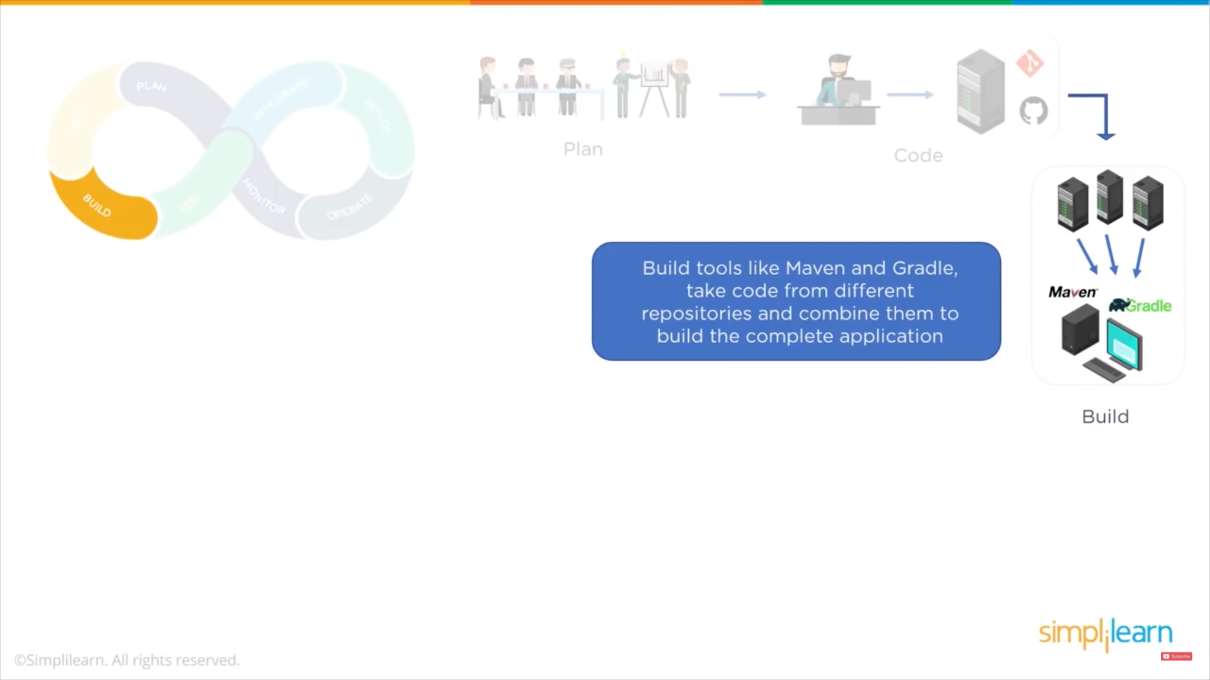

Slide 8
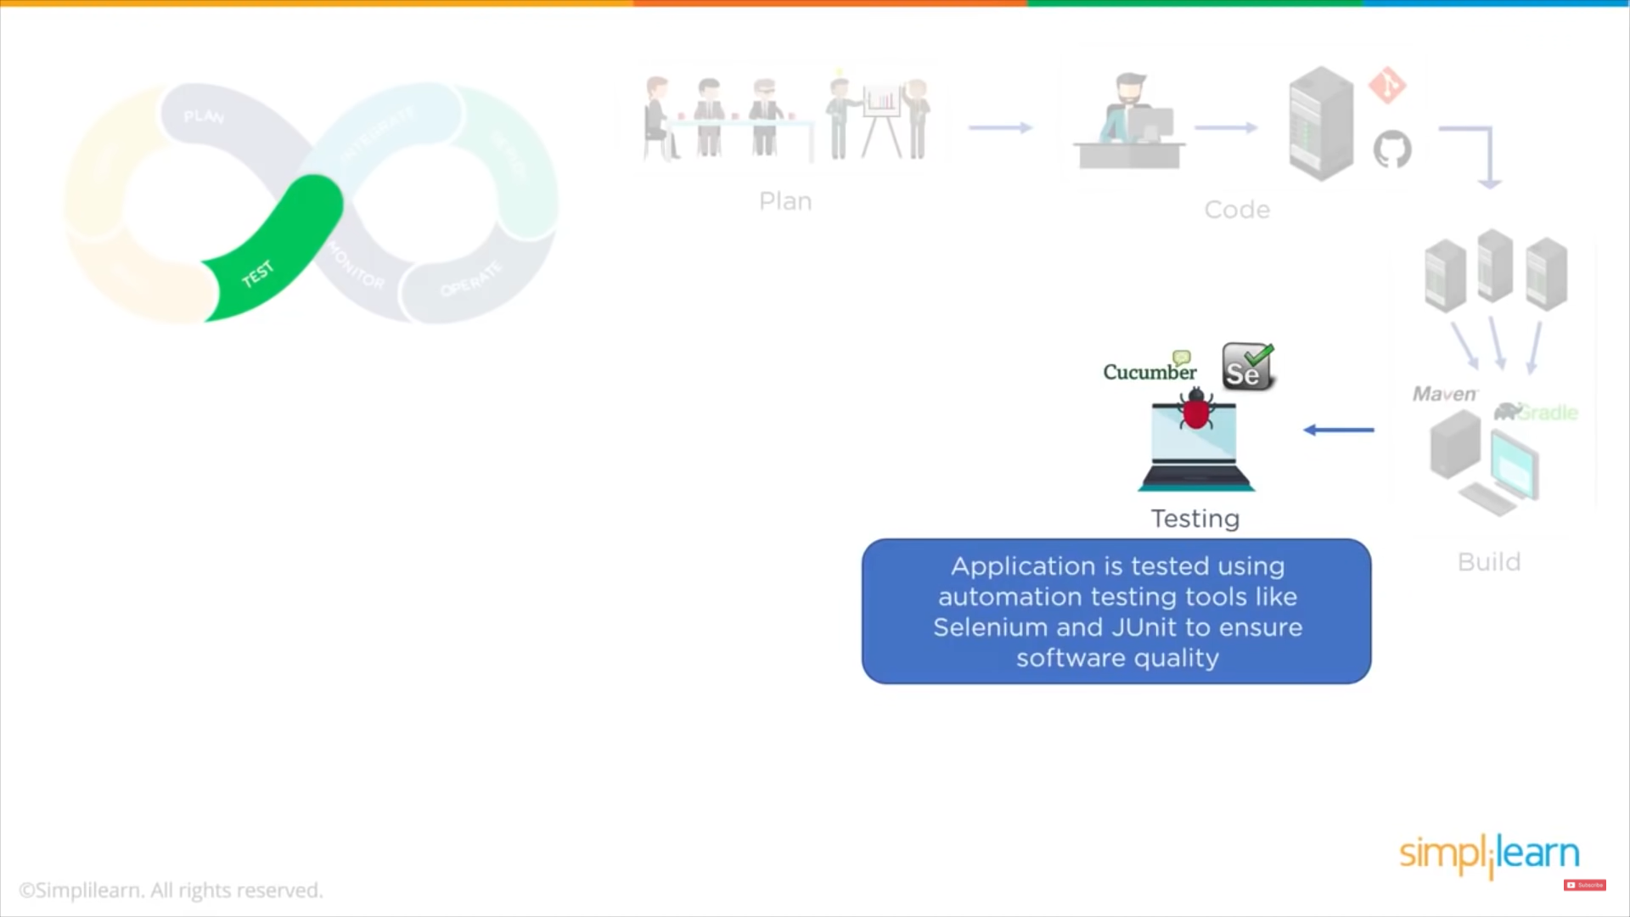

Slide 9
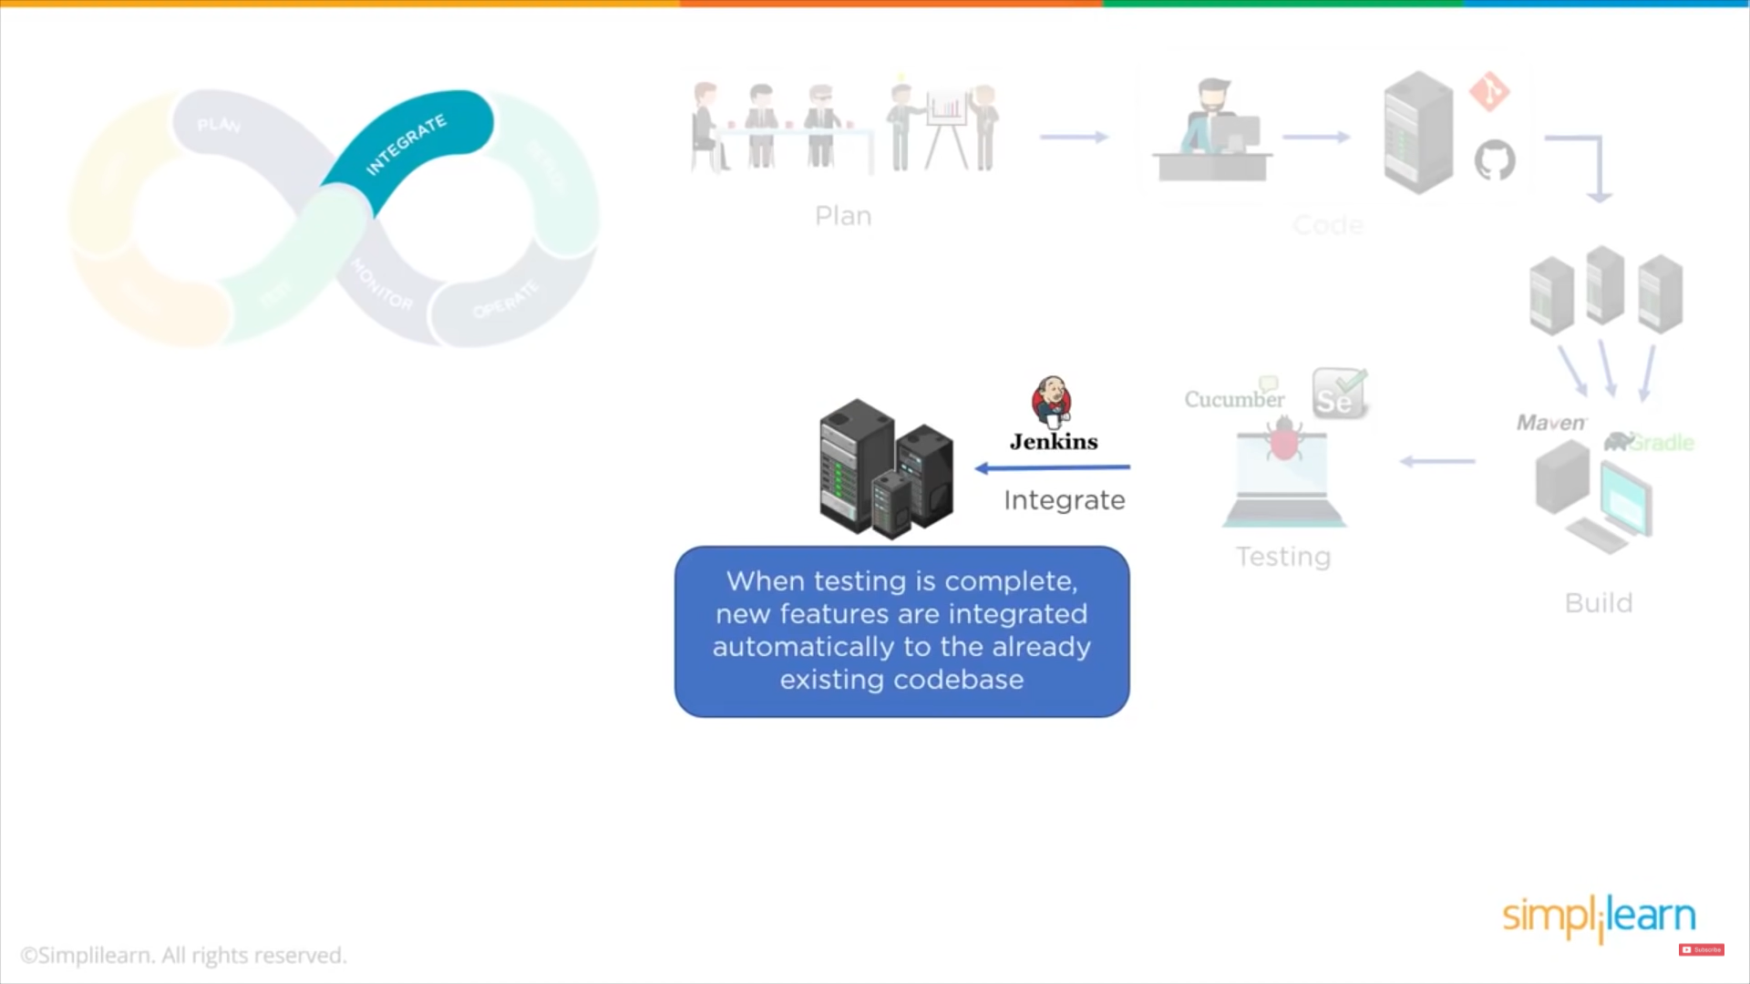

Slide 10
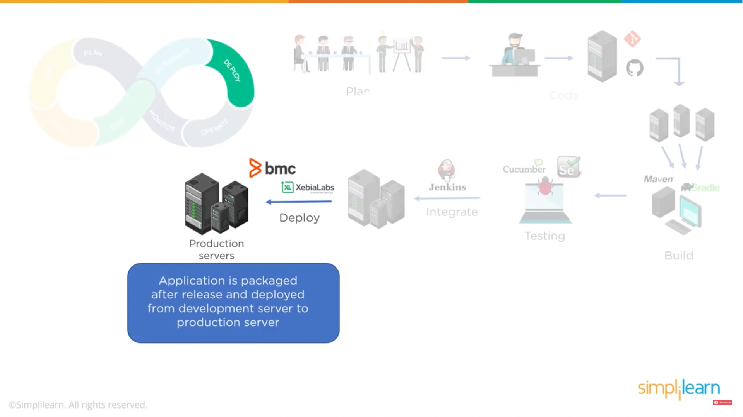

Slide 11
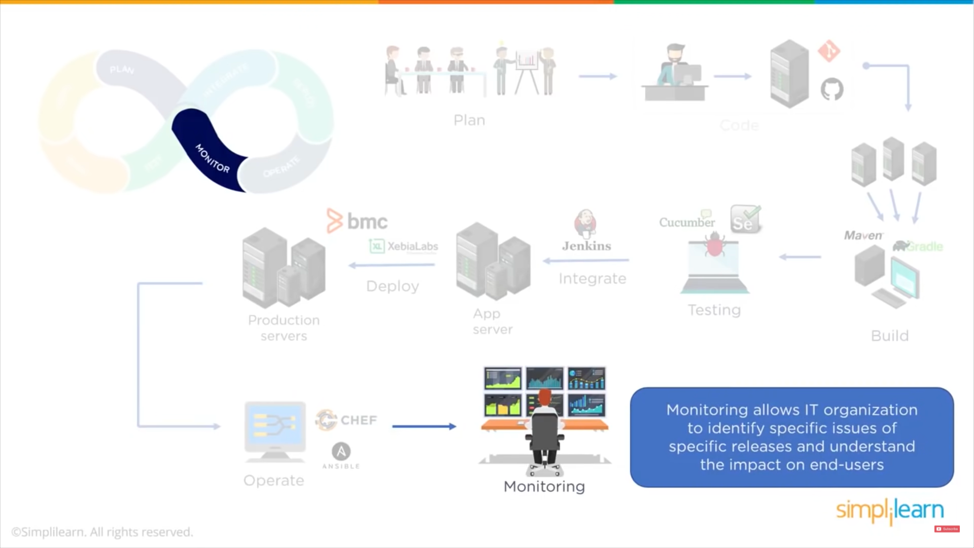

Slide 12
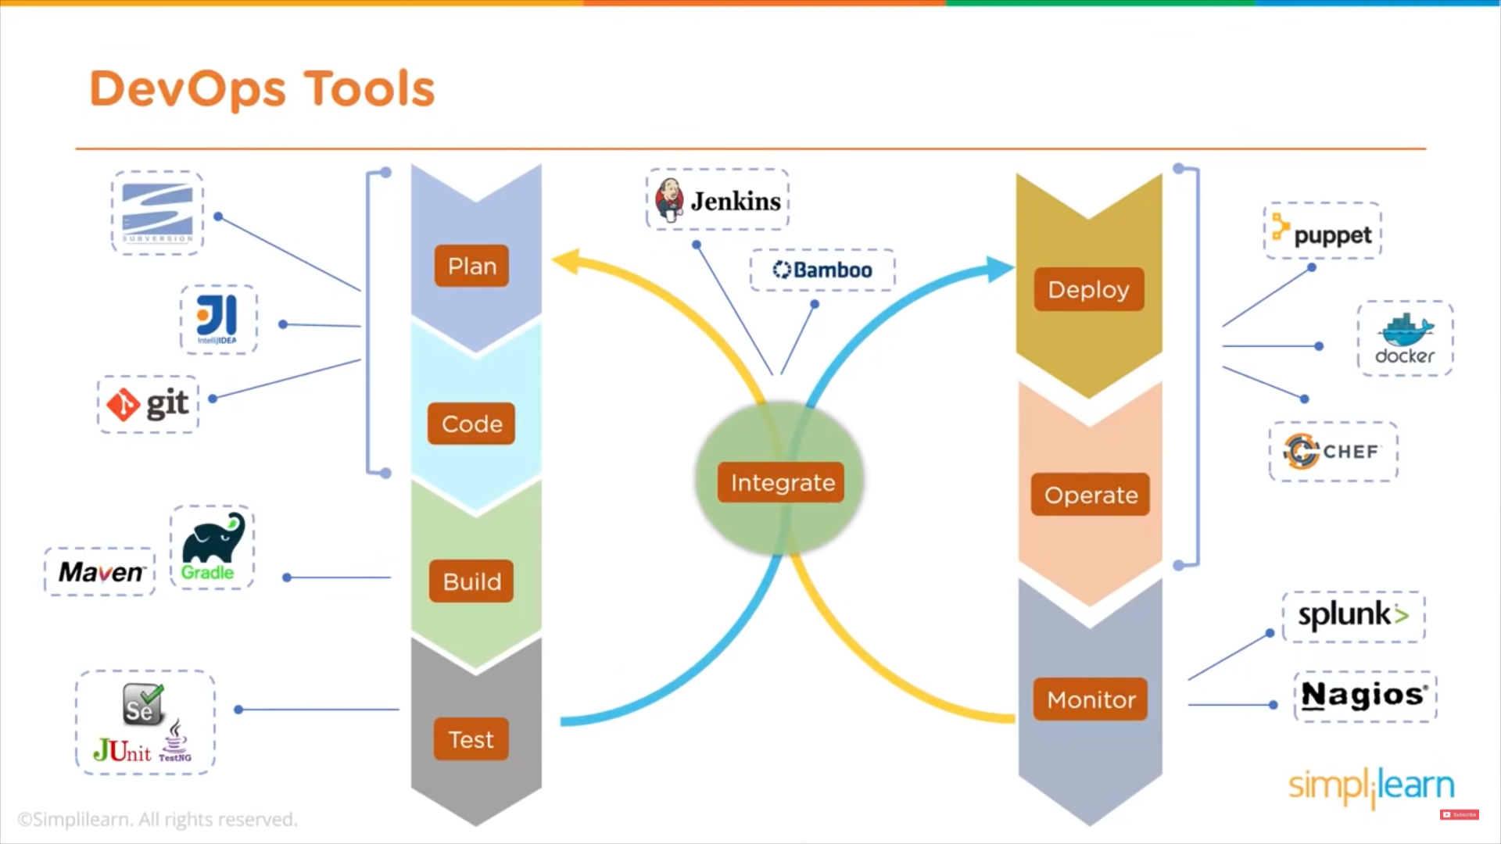

Slide 13
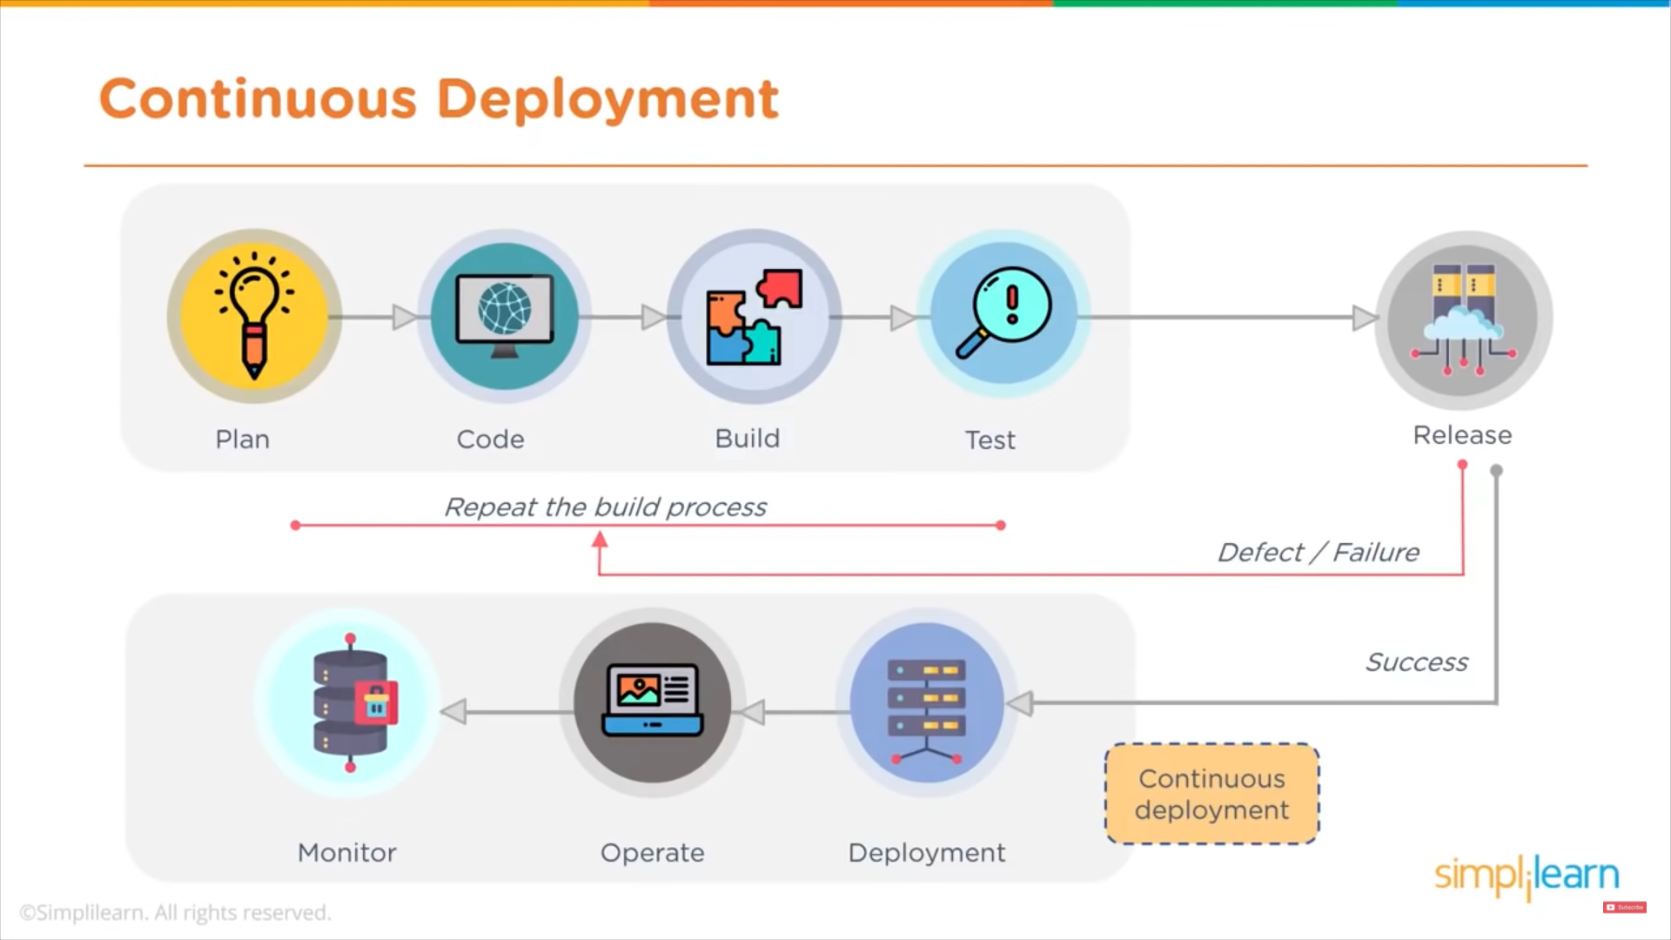

Slide 14
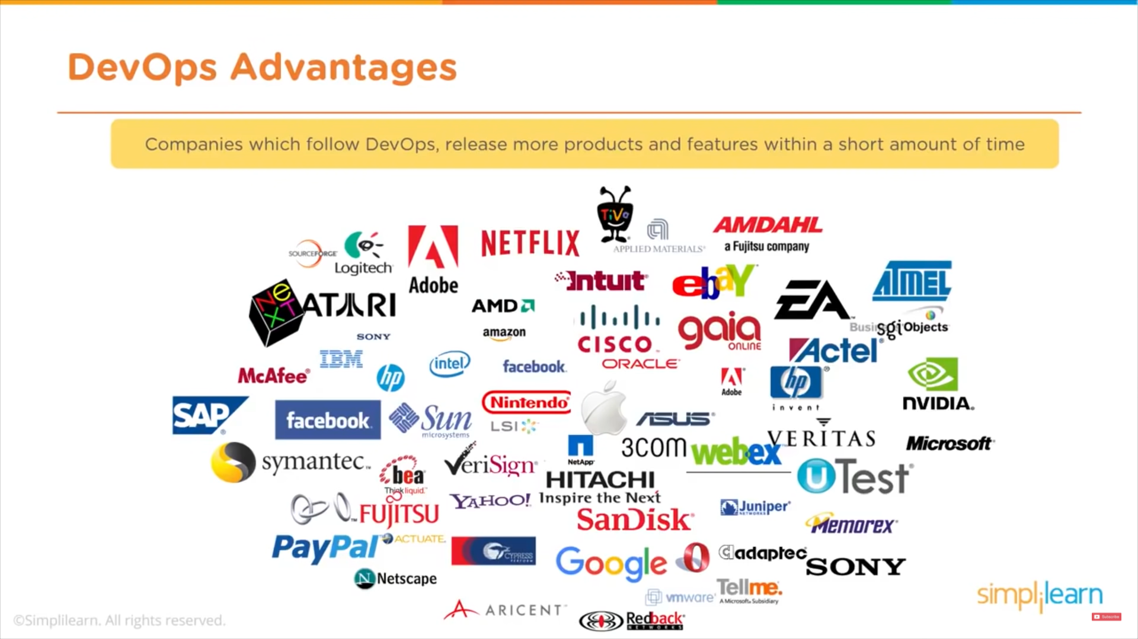

Slide 15
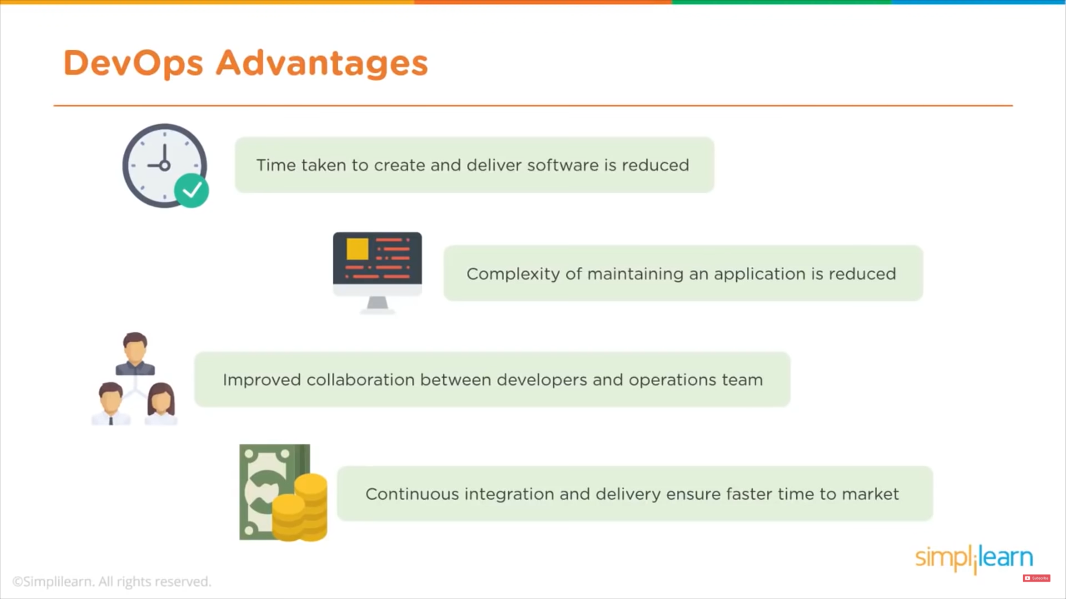

Slide 16
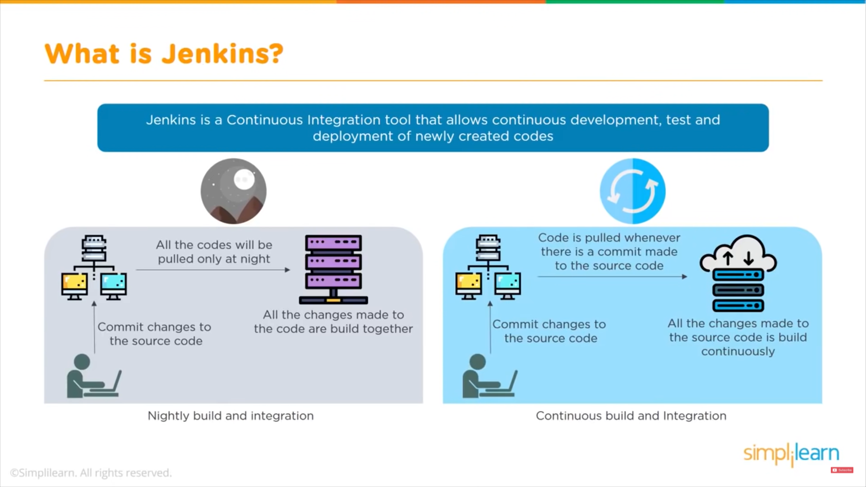

Slide 17
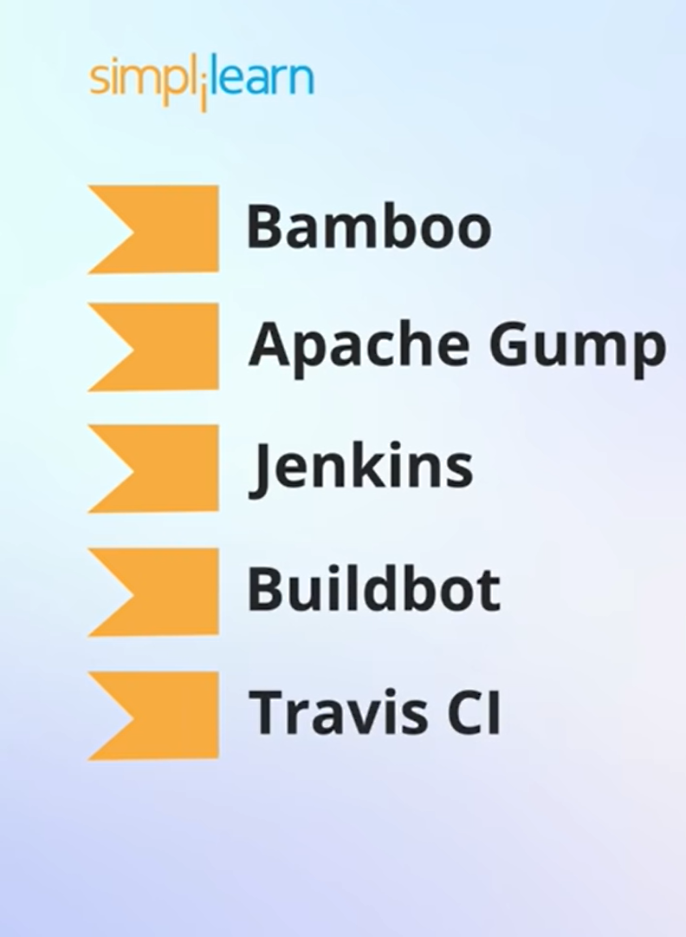
Tools Similar to Jenkins

Slide 18
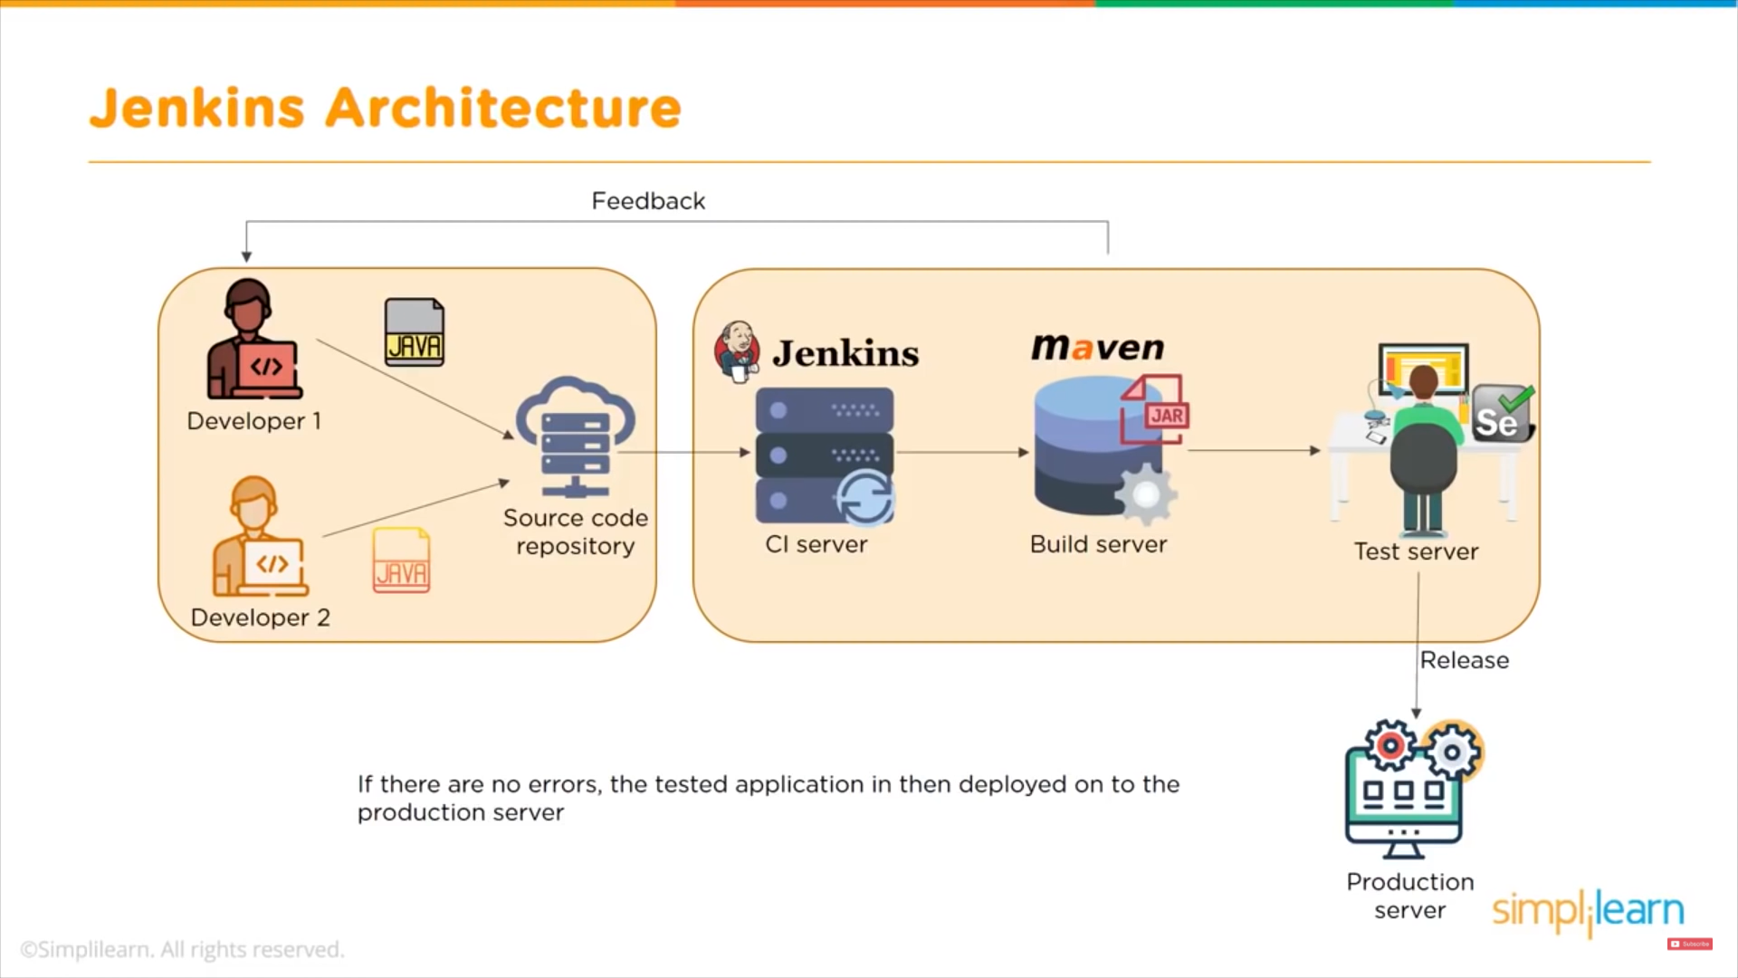

Slide 19

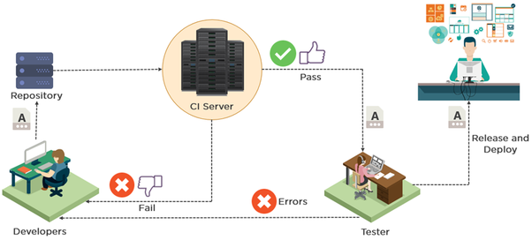
Version control repositories

Slide 20
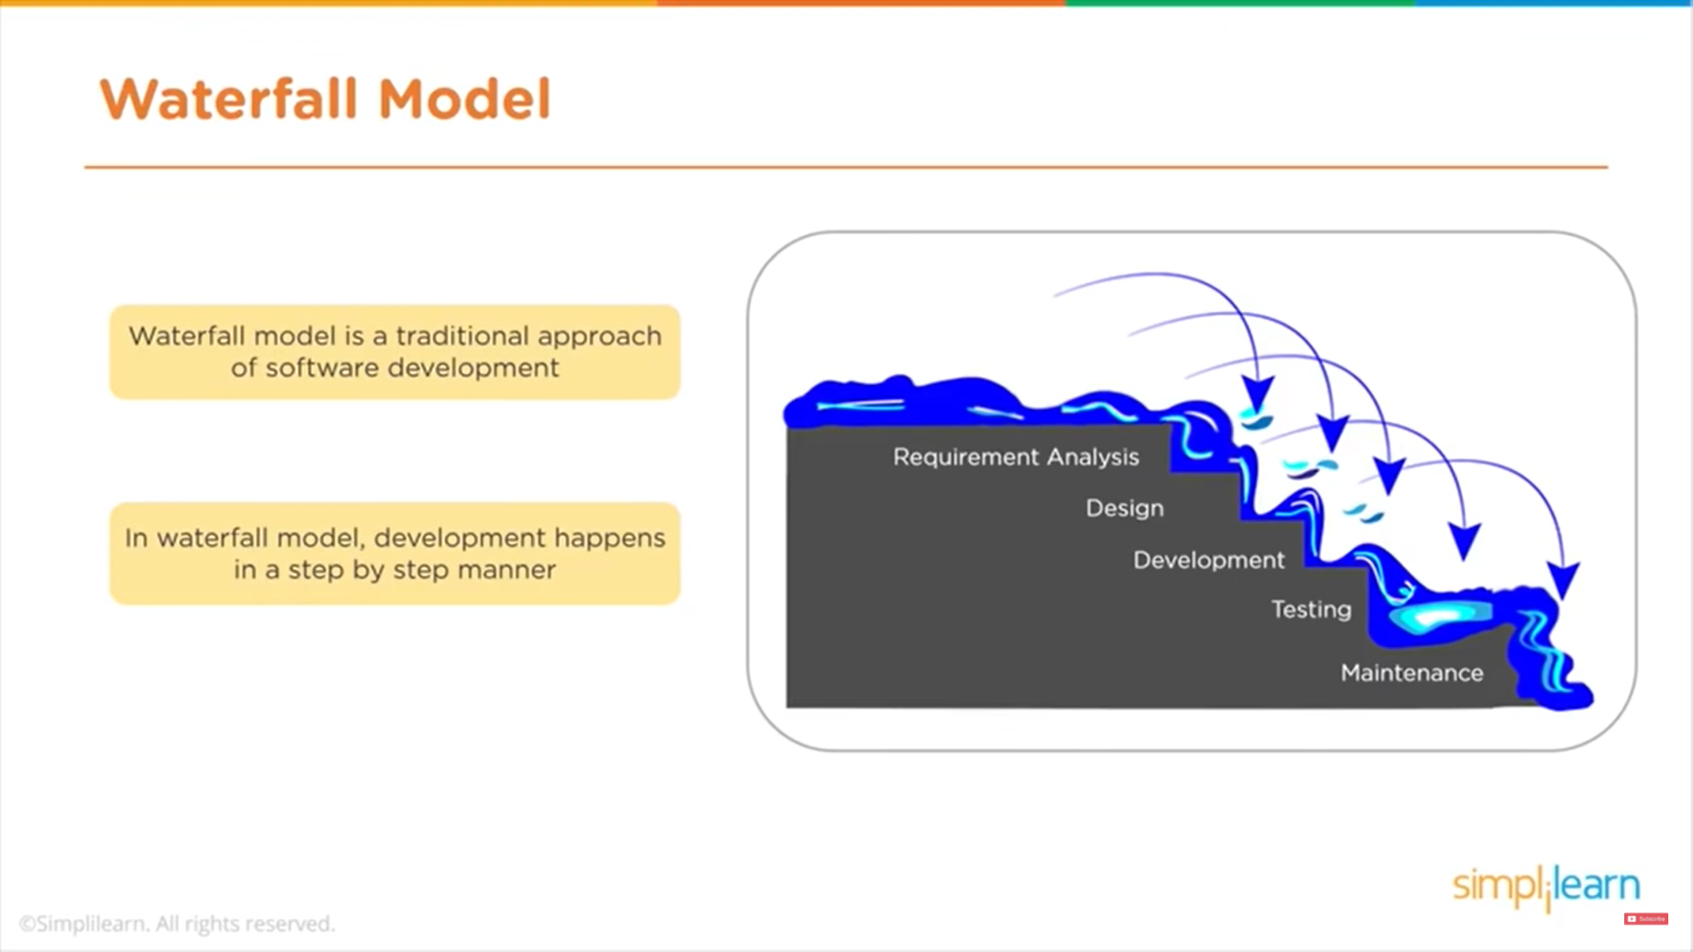

Slide 21
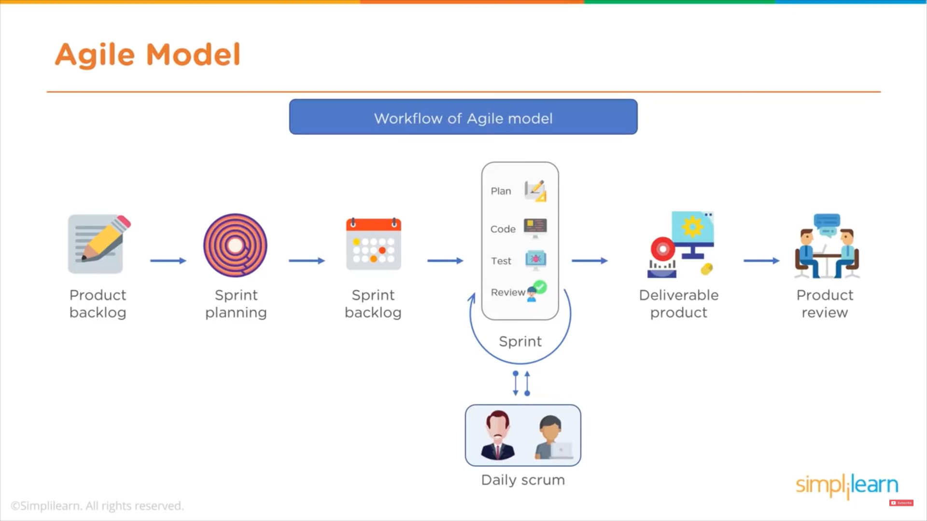

Slide 22
Jenkins Installation

